Slide 1
Unit I

Slide 2
ORIGIN AND CHALLENGES OF NLP
Natural language processing (NLP) is
- A field of computer science, artificial intelligence (also called machine learning), and linguistics
- Concerned with the interactions between computers and human (natural) languages.
- Specifically, the process of a computer extracting meaningful information from natural language input and/or producing natural language output ”

Slide 3
Human Vs Machine with regard to Language processing For humans, learning in early childhood occurs in a consistent way;
children interact with unstructured data and process that data into information.
After amassing this information, we begin to analyze information in an attempt to understand its implications in a given situation or the nuance of a given problem.
We understand that at a certain point, we have a learned understanding of our life and environment.
Only after understanding implications, can the information be used to solve a set of problems or life situations.
Humans iterate through multiple scenarios to consciously or unconsciously simulate whether a solution will be a success or failure.
After practice with this unstructured data -> information -> knowledge ->wisdom

Slide 4
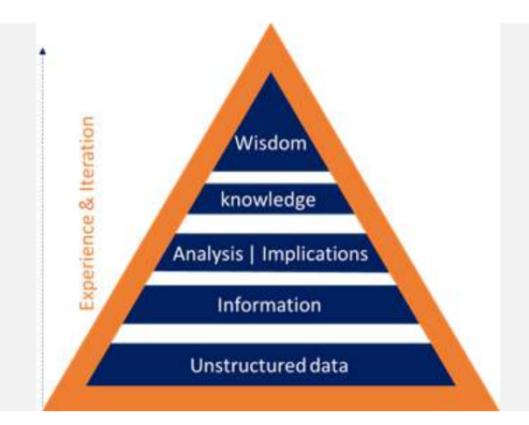

Slide 5
Machines learn by a similar method
initially, the machine translates unstructured textual data into meaningful terms
then identifies connections between those terms
finally comprehends the context.
Many technologies conspire to process natural languages, the most popular of which are Stanford CoreNLP, Spacy, AllenNLP, and Apache NLTK, amongst others. We have come so far in NLP and Machine Cognition, but still, there are several challenges that must be overcome, especially when the data within a system lacks consistency.
We have come so far in NLP and Machine Cognition, but still, there are several challenges that must be overcome, especially when the data within a system lacks consistency.

Slide 6
CHALLENGES OF NLP FOR ML
Below are the steps involved and some challenges that are faced in the machine learning process for NLP
1. Challenge: Breaking the sentence
Formally referred to as “sentence boundary disambiguation”, this breaking process is no longer difficult to achieve, but is nonetheless, a critical process, especially in the case of highly unstructured data that includes structured information. A breaking application should be intelligent enough to separate paragraphs into their appropriate sentence units; Highly complex data might not always be available in easily recognizable sentence forms. This data may exist in the form of tables, graphics, notations, page breaks, etc., which need to be appropriately processed for the machine to derive meanings in the same way a human would approach interpreting text.
Solution: Tagging the parts of speech (POS) and generating dependency graphs

Slide 7
NLP applications employ a set of POS tagging tools that assign a POS tag to each word or symbol in a given text. Subsequently, the position of each word in a sentence is determined by a dependency graph, generated in the same procedure. Those POS tags can be further processed to create meaningful single or compound vocabulary terms.

Slide 8
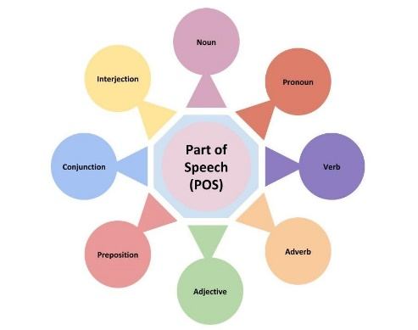

Slide 9
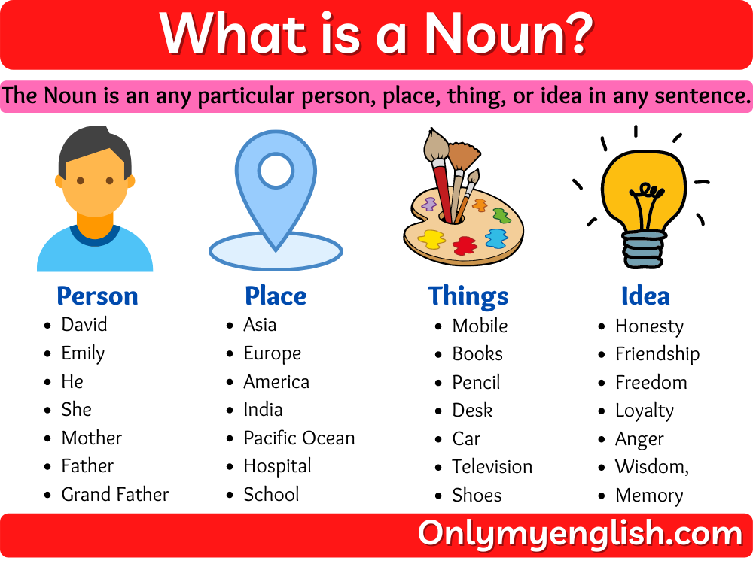
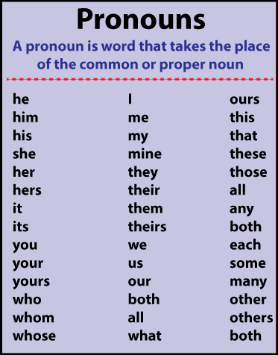
A noun is a word that refers to a thing (book), a person (Noah Webster), an animal (cat), a place (Omaha), a quality (softness), an idea (justice), or an action (yodeling).

Slide 10
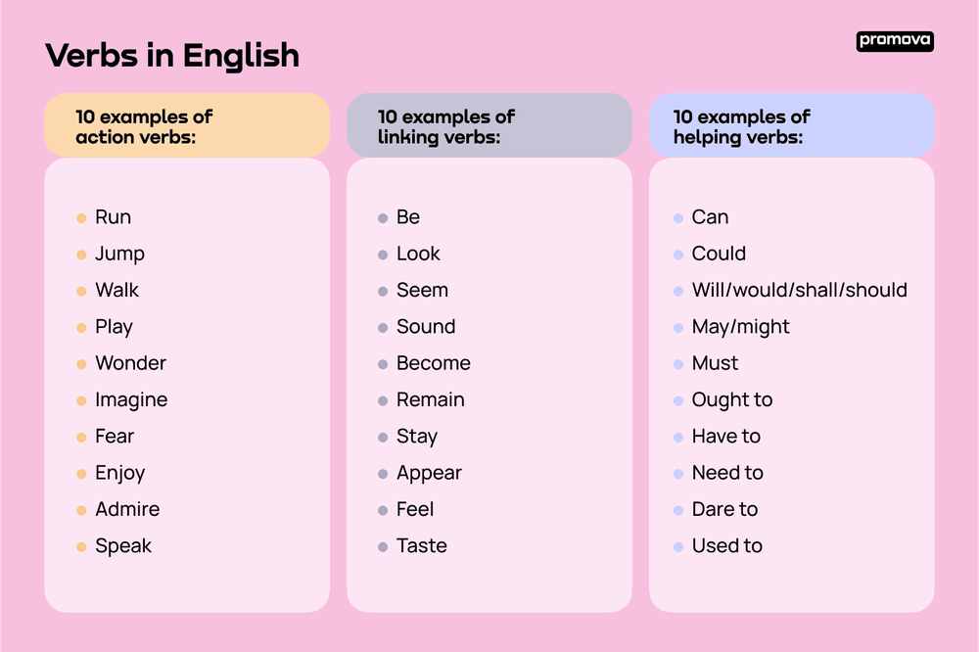
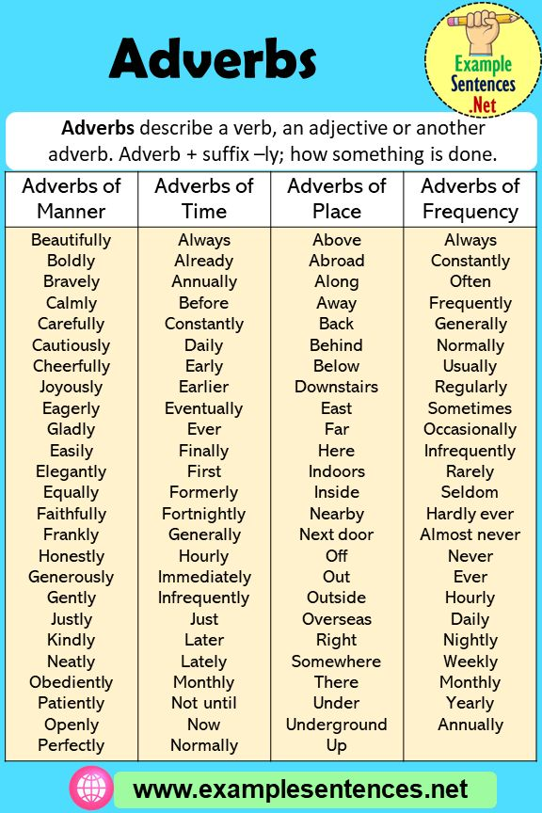

Slide 11
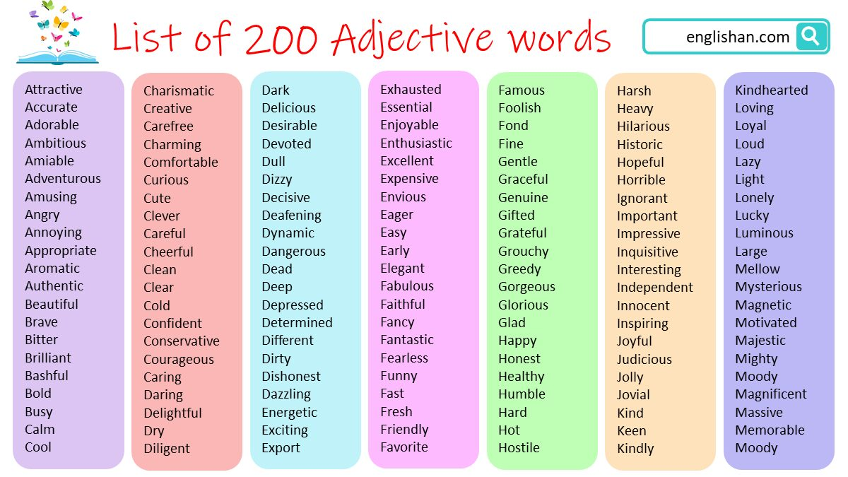

Slide 12
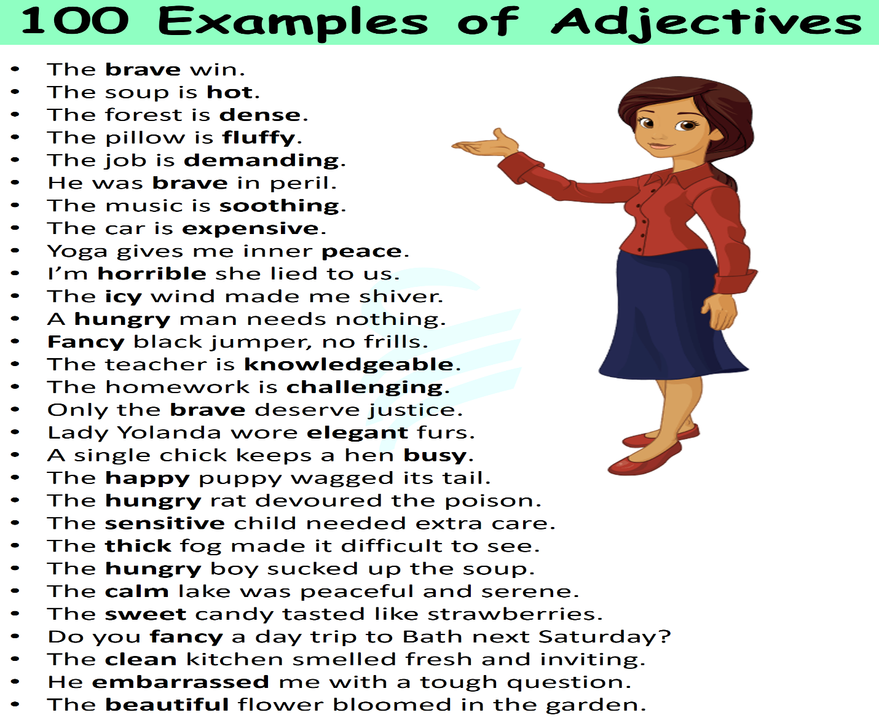
Adjectives are words that describe the qualities or states of being of nouns. They can also describe the quantity of nouns.

Slide 13
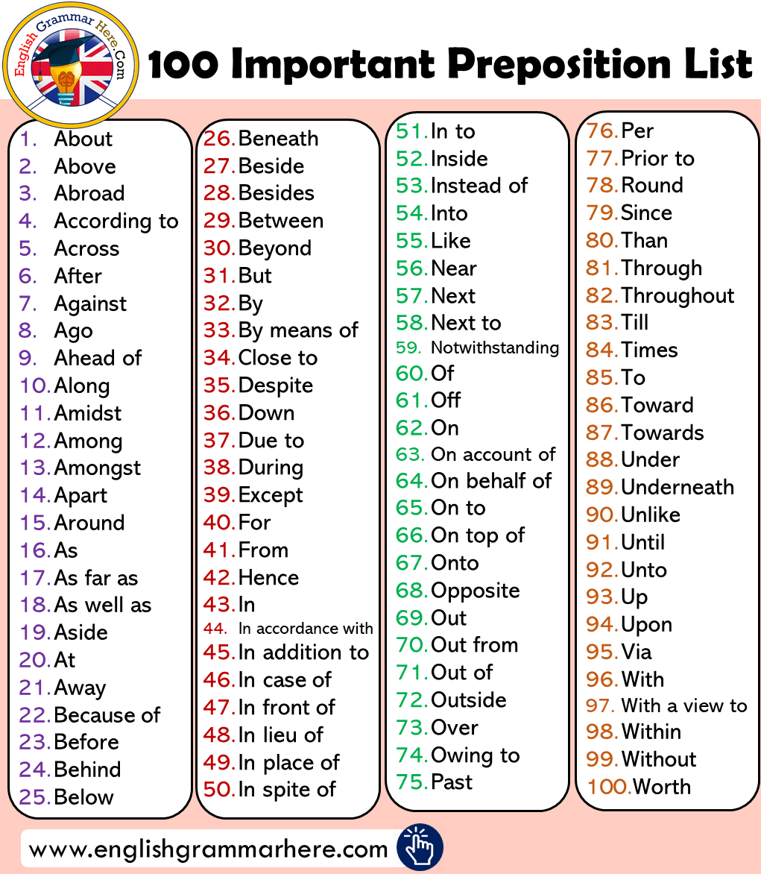
Prepositions often tell us where one noun is in relation to another

Slide 14
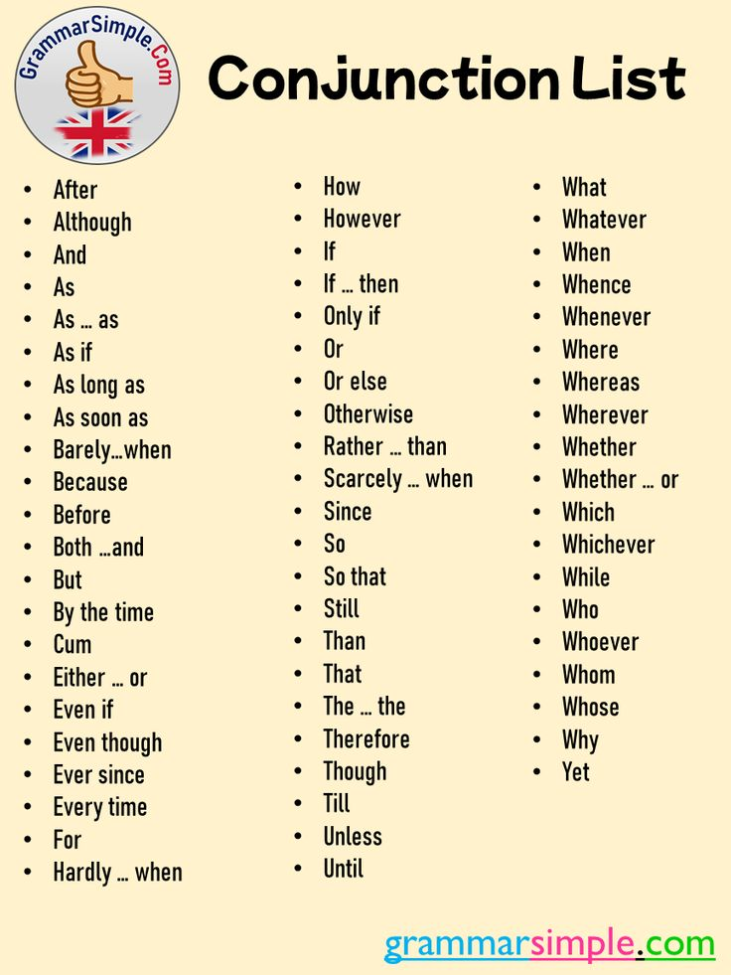
-a word used to connect clauses or sentences or to coordinate words in the same clause (e.g. and, but, if ).
-the action or an instance of two or more events or things occurring at the same point in time or space.

Slide 15
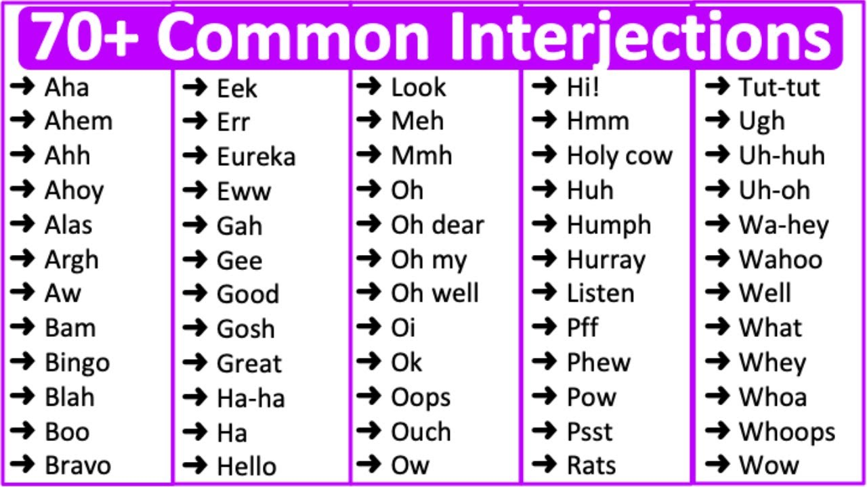
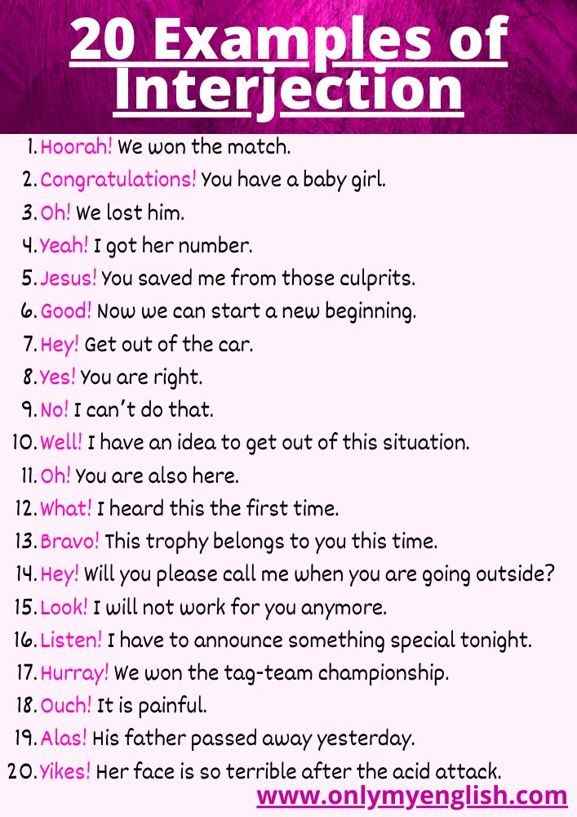
An interjection is a word or phrase that is grammatically independent from the words around it, and mainly expresses feeling rather than meaning. Oh, what a beautiful house! Uh-oh, this looks bad.

Slide 16
2. Challenge: Building the appropriate vocabulary
Using these POS tags and dependency graphs, a powerful vocabulary can be generated and subsequently interpreted by the machine in a way comparable to human understanding.
Example: Consider the following paragraph: “All employees are responsible for the management of risk, with the ultimate accountability residing with the Board. We have a strong risk culture, which is embedded through clear and consistent communication and appropriate training for all employees. A comprehensive risk management framework is applied throughout the Group, with governance and corresponding risk management tools. This framework is underpinned by our risk culture and reinforced by the HSBC Values.” -HSBC annual report 2017

Slide 17
Sentences are generally simple enough to be parsed by a basic NLP program. But to be of real value, an algorithm should also be able to generate, at a minimum, the following vocabulary terms:
Employees; Management of risk; Ultimate accountability; Board; Strong risk culture; Clear and consistent communication; Appropriate training for all employees; Comprehensive risk management framework; Governance and corresponding risk management tools; Framework; Risk culture; HSBC values
Solution: Unfortunately, most NLP software applications do not result in creating a sophisticated set of vocabulary.

Slide 18
3. Challenge: Linking different components of vocabulary
Recently, new approaches have been developed that can execute the extraction of the linkage between any two vocabulary terms generated from the document (or “corpus”).
Solution: Word2vec, a vector-space based model, assigns vectors to each word in a corpus,those vectors ultimately capture each word’s relationship to closely occurring words or set of words. But statistical methods like Word2vec are not sufficient to capture either the linguistics or the semantic relationships between pairs of vocabulary terms.
Example: In the above-stated example, “All employees are responsible for the management of risk, with the ultimate accountability residing with the Board”, two vocabulary terms, “Board” and “management of risk” are connected with the Board having ultimate accountability, but since these two terms are statistically distant, the extent of the relationship bond between this pair cannot be ascertained, neither linguistically nor semantically.
A more sophisticated algorithm is needed to capture the relationship bonds that exist between vocabulary terms and not just words.

Slide 19
4. Challenge: Setting the context
One of the most important and challenging tasks in the entire NLP process is to train a machine to derive context from a discussion within a document. Consider the following two sentences:
“I enjoy working in a bank.”
“I enjoy working near a river bank.”
Solution: There are several methods today to help train a machine to understand the differences between the sentences. Some of the popular methods use custom-made knowledge graphs where, for example, both possibilities would occur based on statistical calculations. When a new document is under observation, the machine would refer to the graph to determine the setting before proceeding.
One challenge in building the knowledge graph is domain specificity. Knowledge graphs cannot, in a practical sense, be made to be universal.

Slide 20
5. Extracting semantic meanings
Linguistic analysis of vocabulary terms might not be enough for a machine to correctly apply learned knowledge. To successfully apply learning, a machine must understand further, the semantics of every vocabulary term within the context of the documents.
By way of example, consider two sentences:
“Under US GAAP, gains and losses from AFS assets are included in net income.”
“Under IFRS, gains and losses from AFS assets are included in comprehensive income.”
Both sentences have the context of gains and losses in proximity to some form of income, but the resultant information needed to be understood is entirely different between these sentences due to differing semantics. It is a combination, encompassing both linguistic and semantic methodologies that would allow the machine to truly understand the meanings within a selected text.

Slide 21
6. Extracting named entities (often referred to as Named Entity Recognition = NER)
Challenge: The next big challenge is to successfully execute NER, which is essential when training a machine to distinguish between simple vocabulary and named entities. In many instances, these entities are surrounded by dollar amounts, places, locations, numbers, time, etc., it is critical to make and express the connections between each of these elements, only then may a machine fully interpret a given text.
Solution: This problem, however, has been solved to a greater degree by some of the famousNLP companies such as Stanford CoreNLP, AllenNLP, etc.

Slide 22
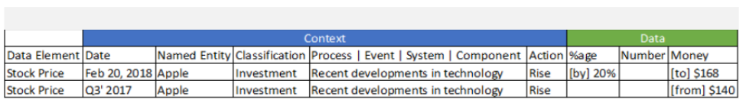
7. Use Case: Transforming unstructured data into structured format
Challenge: Putting the unstructured data into a format that could be reusable for analysis. Historically, the same task has been done only manually by humans.
Example: Consider the following example that contains a named entity, an event, a financial element and its values under different time scales.
“The recent developments in technology have enabled the stock price of Apple to rise by 20%to $168 as at Feb 20, 2018 from $140 in Q3 2017.”
Think of this sentence broken down into the following structure:

Slide 23
This is extremely challenging through linguistics. Not all sentences are written in a single fashion since authors follow their unique styles. While linguistics is an initial approach towar dextracting the data elements from a document, it doesn’t stop there. The semantic layer that will understand the relationship between data elements and its values and surroundings have to be machine-trained too to suggest a modular output in a given format.

Slide 24
CHALLENGES OF NLP FOR AI
Artificial intelligence has become part of our everyday lives – Alexa and Siri, text and email autocorrect, customer service chatbots.
They all use machine learning algorithms to process and respond to human language.
A branch of machine learning AI, called Natural Language Processing (NLP), allows machines to “understand” natural human language.
A combination of linguistics and computer science, NLP works to transform regular spoken or written language into something that can be processed by machines.

Slide 25
NLP is a powerful tool with huge benefits, but there are still a number of Natural Language Processing limitations and problems:
1. Contextual words and phrases and homonyms
2. Synonyms
3. Irony and sarcasm
4. Ambiguity
5. Errors in text or speech
6. Colloquialisms and slang
7. Domain-specific language
8. Low-resource languages
9. Lack of research and development

Slide 26
1. Contextual words and phrases and homonyms
The same words and phrases can have different meanings according the context of a sentence and many words – especially in English – have the exact same pronunciation but totally different meanings.
For example:
I ran to the store because we ran out of milk.
Can I run something past you real quick?
The house is looking really run down.
These are easy for humans to understand because we read the context of the sentence and we understand all of the different definitions. And, while NLP language models may have learned all of the definitions, differentiating between them in context can present problems. Homonyms – two or more words that are pronounced the same but have different definitions– can be problematic for question answering and speech-to-text applications because they aren’t written in text form. Usage of their and there, for example, is even a common problem for humans.

Slide 27
2. Synonyms
Synonyms can lead to issues similar to contextual understanding because we use many different words to express the same idea. Furthermore, some of these words may convey exactly the same meaning, while some may be levels of complexity (small, little, tiny, minute) and different people use synonyms to denote slightly different meanings within their personal vocabulary.
So, for building NLP systems, it’s important to include all of a word’s possible meanings and all possible synonyms. Text analysis models may still occasionally make mistakes, but the more relevant training data they receive, the better they will be able to understand synonyms

Slide 28
3. Irony and sarcasm
Irony and sarcasm present problems for machine learning models because they generally usewords and phrases that, strictly by definition, may be positive or negative, but actuallyconnote the opposite.
Models can be trained with certain cues that frequently accompany ironic or sarcastic phrases, like “yeah right,” “whatever,” etc., and word embeddings (where words that have the same meaning have a similar representation), but it’s still a tricky process.

Slide 29
4. Ambiguity
Ambiguity in NLP refers to sentences and phrases that potentially have two or more possible interpretations. NLP has the following types of ambiguities
Lexical ambiguity: The ambiguity of a single word is called lexical ambiguity. A word that could be used as a verb, noun, or adjective For example, treating the word silver as a noun, an adjective, or a verb.
Semantic ambiguity: the interpretation of a sentence in context. This kind of ambiguity occurs when the meaning of the words themselves can be misinterpreted. In other words, semantic ambiguity happens when a sentence contains an ambiguous word or phrase.
For example, the sentence “The car hit the pole while it was moving” is having semantic ambiguity because the interpretations can be “The car, while moving, hit the pole” and “The car hit the pole while the pole was moving.

Slide 30
Syntactic ambiguity: This kind of ambiguity occurs when a sentence is parsed indifferent ways. For example, the sentence “The man saw the girl with the telescope”. It is ambiguous whether the man saw the girl carrying a telescope or he saw her through his telescope.
Anaphoric Ambiguity: This kind of ambiguity arises due to the use of anaphora entities in discourse. For example, the horse ran up the hill. It was very steep. It soon got tired. Here, the anaphoric reference of “it” in two situations cause ambiguity.
Pragmatic ambiguity: Such kind of ambiguity refers to the situation where the context of a phrase gives it multiple interpretations. In simple words, we can say that pragmatic ambiguity arises when the statement is not specific. For example, the sentence “I like you too” can have multiple interpretations like I like you (just like you like me), I like you (just like someone else dose)
Even for humans this sentence alone is difficult to interpret without the context of surrounding text. POS (part of speech) tagging is one NLP solution that can help solve the problem, somewhat.

Slide 31
5. Spelling Errors in text
Misspelled or misused words can create problems for text analysis. Spelling mistakes can occur for a variety of reasons, from typing errors to extra spaces between letters or missing letters.
Autocorrect and grammar correction applications can handle common mistakes, but don’t always understand the writer’s intention.
Cosine similarity is one of the methods used to find the correct word when a spelling mistake has been detected. Cosine similarity is calculated using the distance between two words by taking a cosine between the common letters of the dictionary word and the misspelled word. This way we can find different combinations of words that are close to the misspelled word by setting a threshold to the cosine similarity and identifying all the words above the set threshold as possible replacement words.
For example, if the misspelled word is “speling,” the system will find the correct word:“spelling.”

Slide 32
6. Colloquialisms and slang
Informal phrases, expressions, idioms, and culture-specific lingo present a number of problems for NLP – especially for models intended for broad use. Because as formal language, colloquialisms may have no “dictionary definition” at all, and these expressions may even have different meanings in different geographic areas. Furthermore, cultural slang is constantly morphing and expanding, so new words pop up every day.
This is where training and regularly updating custom models can be helpful, although it often times requires quite a lot of data.

Slide 33
7. Domain-specific language
Different businesses and industries often use very different language. An NLP processing model needed for healthcare, for example, would be very different than one used to process legal documents. These days, however, there are a number of analysis tools trained for specific fields, but extremely niche industries may need to build or train their own models.

Slide 34
8. Low-resource languages
AI machine learning NLP applications have been largely built for the most common, widely used languages.
However, many languages, especially those spoken by people with less access to technology often go overlooked and under processed. For example, by some estimations, (depending on language vs. dialect) there are over 3,000 languages in Africa,alone. There simply isn’t very much data on many of these languages.
However, new techniques, like multilingual transformers (using Google’s BERT“Bidirectional Encoder Representations from Transformers”) and multilingual sentence embeddings aim to identify and leverage universal similarities that exist between languages.

Slide 35
9. Lack of research and development
Machine learning requires A LOT of data to function to its outer limits – billions of pieces of training data. The more data NLP models are trained on, the smarter they become. That said,data (and human language!) is only growing by the day, as are new machine learning techniques and custom algorithms. All of the problems above will require more research and new techniques in order to improve on them.
Advanced practices like artificial neural networks and deep learning allow a multitude of NLP techniques, algorithms, and models to work progressively, much like the human mind does. As they grow and strengthen, we may have solutions to some of these challenges in the near future.

Slide 36
Preprocessing of Text
Most common challenges we face in NLP are around unstructured data and Big Data. Big Data and unstructured data can be converted into useful/meaningful text by the followingways:
Some of the steps involved in processing text are:
1. Noise Removal
2. Normalization
3. Tokenization
4. Vocabulary
5. Vectorization

Slide 37
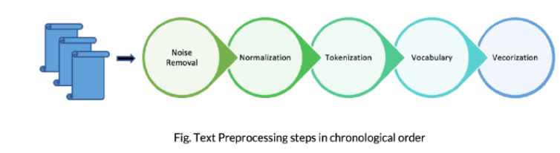

Slide 38
Noise Removal
Remove whitespaces
Remove HTML tags
Remove unwanted URLs
Convert accented characters
Remove special characters
Remove words
Remove stop words
Normalization
Lowercasing characters
Expanding contractions (Convert abbreviations or into complete words -“can’t”becomes “can not”, MCC into Madras Christian College).
Numeric words to numbers
Stemming / Lemmatization (converting the word to its meaningful base form)Tokenization
Tokenization (splitting the text into sentences or splitting the sentences into words)Vocabulary
Remove duplicate words
Build Vocabulary Vectorization
Word Embedding's
Once you have the pre-processing steps done, you are ready to begin building foundational NLP models.

Slide 39
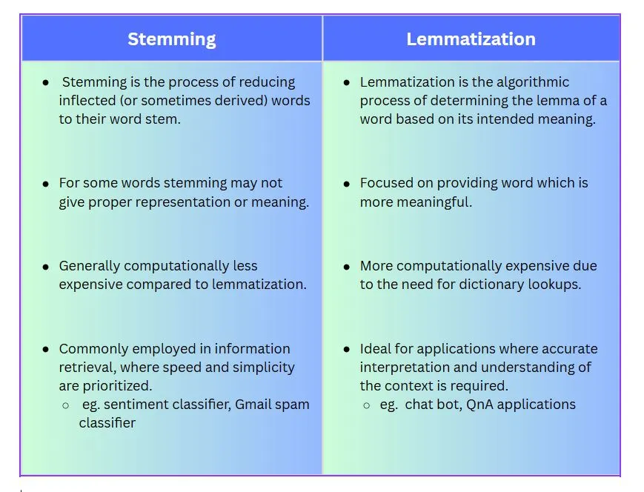
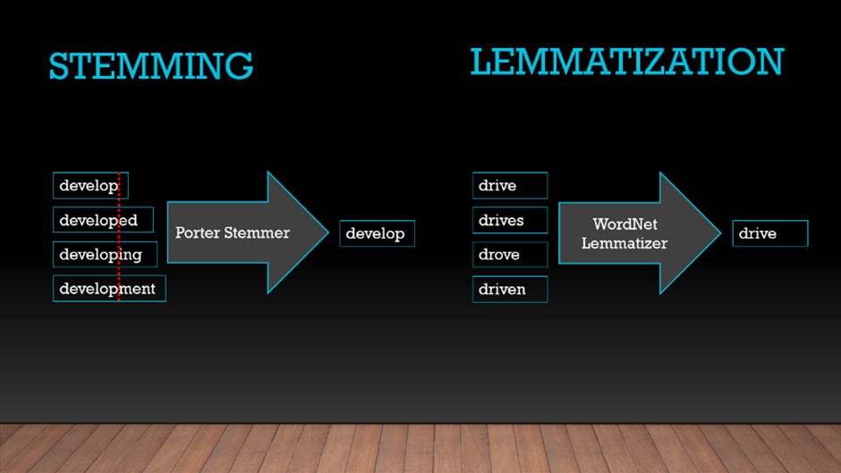

Slide 40
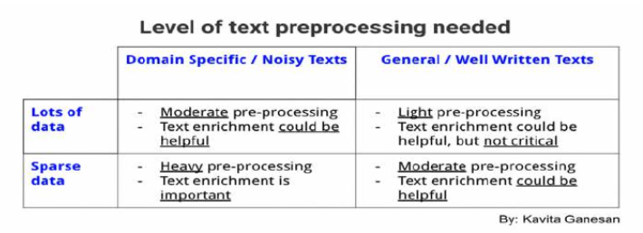

Slide 41
LANGUAGE MODELS IN NLP
Writing an email is something we do while walking on the road also. The most official mode of communication, So, have you ever seen the ‘Smart Compose’ feature automatically working in your Gmail giving you instant ideas to finish sentences while composing an email? This is one of the different use-instances of language models utilized in Natural Language Processing (NLP).
A language model is the core heart of the present day Natural Language Processing (NLP) domain.

Slide 42
What do you mean by Language Modeling?
In a broader sense, Language Modeling (LM) is the technique for utilization of different factual and probabilistic procedures to decide the occurrence of a given group of words happening in a corpus / sentence.
These models help to examine collections of text information to give a premise to their base and forecast a prediction.
They are highly utilized in natural language processing (NLP) applications, especially the models that produce text as a yield.
A portion of these applications also incorporate language translation, text summarization, audio to text conversion, sentiment analysis, and answering queries.

Slide 43
Working Principle of Language Modeling
Language models decide the probability of occurrence of a word by dissecting text information. They decipher this information by taking care of not affecting the actual text but building a calculation that makes up rules for setting in natural language.
Then, at that point, the model applies these principles in language undertakings to precisely foresee or create new sentences. The model basically learns the highlights and qualities of fundamental language and utilizes those highlights to see new expressions.
There are a few distinctive probabilistic ways to deal with language modeling. For instance, a language model intended to produce sentences for a customized Twitter bot may utilize distinctive math and examine text information in an unexpected manner in comparison to a language model intended for deciding the probability of a pursuit question.

Slide 44
Few of the most commonly used language modeling types include:
Unigram:
The unigram is the most straightforward sort of language model. It doesn’t take a gander at any molding setting in its computations. It assesses each word or term freely. A unigram is a sequence of one token or word. For instance,
let us consider the following sentence: I love to read and write blogs about Machine learning. So, the formation of unigram will be: “I”, “love”, “to”, “read”, “and”, “write”, “blogs”, “about”, “machine”, “learning”.
Unigram models usually handle language preparing errands like data recovery. They establish a more explicit model variation called the inquiry probability model, which utilizes data recovery to analyze a pool of archives and match the most applicable one to a particular question.

Slide 45
N-gram:
The N-gram language model helps to predict the probability within any group of words, for a given N-gram within the language. A good N-gram model allows us to predict p(w | h). N-grams are a much simpler approach to deal with language models.
They make a probability dispersion for an arrangement of n; where n can be any number, and characterizes the size of the gram, or succession of words being appointed a likelihood. A few kinds of n-grams are unigrams, bigrams, trigrams, etc.

Slide 46
Bidirectional:
Quite unsimilar to n-gram models, which examine text one way or more precisely in reverse direction, bidirectional models investigate text in both two ways.
These models can foresee any word in a corpus or assortment of text by utilizing each and every word present in the content. Analyzing text bidirectionally expands result exactness.

Slide 47

The importance of Language Modeling
Language demonstrating is critical in current NLP applications. It is the explanation that machines can comprehend subjective data. Every language model sort, somehow, transforms subjective data into quantitative data. This permits individuals to speak with machines as they do with one another partly.

Slide 48

Application of Language Modeling
The foundation of Natural Language Processing completely depends on language modeling. The following are some NLP assignments that utilization language demonstrating, what they mean, and a few uses of those errands:
Assessment investigation – It includes deciding the conclusion behind a given expression. In particular, it tends to be utilized to get conclusions and mentalities communicated in a content. Organizations can utilize this to break down item audits or general posts about their item

Slide 49
Discourse acknowledgment – It includes a machine having the option to handle discourse sound. This is regularly utilized by voice aides like Siri and Alexa.
Parsing – It includes examination of any line of information or sentence that adjusts to formal language and punctuation rules. In language displaying or more accurately modeling, this may appear as sentence charts that portray each word’s relationship to the others.
Optical character acknowledgment – It includes the utilization of a machine to change over pictures of text into machine encoded text. The picture might be a filtered report or record photograph, or a photograph with text and sign on some places, for instance.

Slide 50
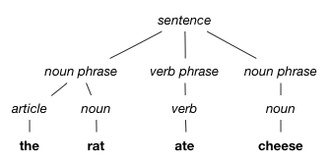
Parsing

Slide 51
Machine interpretation or translation – As humans, we fail to understand all the languages available and so to this problem, a machine is developed which includes the interpretation of one language to another. Some applications of machine translator are Google Translate and Microsoft Translator which work on the principles of NLP.
Grammatical forms labeling – It includes the markup and arrangement of words by certain linguistic attributes. This is used in the investigation of etymology, first and maybe most broadly in the investigation of the Brown Corpus, an assemblage made out of irregular English writing that was intended to be concentrated by PCs. This corpus allows data scientists to prepare highly sophisticated language models, a real-time example is the one utilized by Google to improve its search quality.
Data recovery – It includes looking in a report for data, looking for archives when all is said in done, and looking for metadata that compares to a record. Internet browsers are the most well-known data recovery applications.

Slide 52
What is statistical language modeling in NLP?
Statistical Language Modeling, or Language Modeling and LM for short, is the development of probabilistic models that can predict the next word in the sequence given the words that precede it.
A statistical language model learns the probability of word occurrence based on examples of text. Simpler models may look at a context of a short sequence of words, whereas larger models may work at the level of sentences or paragraphs. Most commonly, language models operate at the level of words.

Slide 53
What are the types of statistical language models?
Statistical models include the development of probabilistic models that are able to predict the next word in the sequence, given the words that precede it. A number of statistical language models are in use already. Let’s take a look at some of those popular models:
N-Gram
Exponential
Continuous Space

Slide 54
‍How do you build a simple Statistical Language Model?
Language models start with a Markov Assumption. This is a simplifying assumption that the k+1st word is dependent on the previous k words. A 2nd order assumption results in a Bigram model. The models are training using Maximum Likelihood Estimations (MLE) of an existing corpus. The MLE approach then is simply a fraction of work counts.
There are some advantages of using tradition n-gram language models.
They are easy to train on a large corpus
They work surprisingly well in most tasks!!

Slide 55
What are the applications of statistical language modeling?
Statistical language models are used to generate text in many similar natural language processing tasks, such as:
Speech Recognization
Voice assistants such as Siri and Alexa are examples of how language models help machines in processing speech audio.
Machine Translation
Google Translator and Microsoft Translate are examples of how NLP models can help in translating one language to another.
Sentiment Analysis
This helps in analyzing sentiments behind a phrase. This use case of NLP models is used in products that allow businesses to understand a customer’s intent behind opinions or attitudes expressed in the text. Hubspot’s Service Hub is an example of how language models can help in sentiment analysis.
Text Suggestions
Google services such as Gmail or Google Docs use language models to help users get text suggestions while they compose an email or create long text documents, respectively.
Parsing Tools
Parsing involves analyzing sentences or words that comply with syntax or grammar rules. Spell checking tools are perfect examples of language modelling and parsing.

Slide 56
Regular expressions
Simply put, a regular expression is ”instruction” given to a function on what and how to match or replace a set of strings.
Let’s start with some basics in regular expressions, that is some basic syntax you should know.
Brackets [] are used to specify a disjunction of characters. For instance, using the brackets to put w or W allows me to return a capital W or small w.
/[wW]oodchuck/ --> Woodchuck or woodchuck
/[abc]/ --> ‘a’, ‘b’, or ‘c’
/[1234567890]/ --> any digit
If you add a dash, you specify a range. For instance, putting A-Z in brackets allows R to return all matches of an upper case letter.
/[A-Z]/ → machtes an upper case letter
/[a-z]/ → matches a lower case letter
/[0–9]/ → matches a single digit

Slide 57
The caret ^ can be used for negation or just to mean ^.
/[ˆA-Z]/ --> not an upper case letter
/[ˆSs]/ --> neither ‘S’ nor ‘s’
/[ˆ\.]/ --> not a period
/[eˆ]/ --> either ‘e’ or ‘ˆ’
/aˆb/ --> the pattern ‘aˆb’
The question mark ? marks optionality of the previous expression. For instance, putting a ? at the end of the woodchucks returns results for woodchuck (without an s) and woodchucks (with an s).
/woodchucks?/ --> woodchuck or woodchucks
/colou?r/ --> color or colour
You can use the period . to specify any character between two expressions. For instance, putting beg.n will return you words such as begin or begun.
/beg.n/ --> Match any character between beg and n (e.g. begin, begun)

Slide 58
The use of * or +allows you to add 1 or more of a previous character.
oo*h! → 0 or more of a previous character (e.g. ooh!, ooooh!)
o+h! → 1 or more of a previous character (e.g. ooh!, ooooooh!)
baa+ → baa, baaaa, baaaaaa, baaaaaaa
Anchors are used to assert something about the string or the matching process. As such, they are not used in a specific word or character but help with more general queries as you can see in the examples below.
. → any character except a new line
\\w → any word character
\\W → anything but a word character
\\d → any digit character
\\D → anything but a digit character
\\b → a word boundary
\\B → anything but a word boundary
\\s → any space character
\\S → anything but a space character

Slide 59
POSIX character classes are helpful if you want to match a specific character class, e.g. digits. In other words, it makes one small sequence of characters match a larger set of characters.
[[:alpha:]] → alphabetic characters
[[:digit:]] → digits
[[:punct:]] → punctuation
[[:space:]] → space, tab, newline etc.
[[:lower:]] → lowercase alphatic characters
[[:upper:]] → upper case alphabetic characters

Slide 60
strsplit(), grep(), and gsub()
Now this is where the action starts. When dealing with character strings, it is very likely that you’ll have to use the commands strsplit(), grep() and gsub() to activate the input you want R to return to you.
strsplit(x, split)
The example below shows a way of using strsplit to split the words within a sentence, in this case all the words within the dashes “ …”.
richard3 <- “now is the winter of our discontent”
strsplit(richard3, “ “) # the second argument specifies the space

Slide 61
strsplit("R-is-awesome", split = "-") ==➔(Split Strings)
# Output: List containing "R", "is", "awesome”
vec <- c("apple", "banana", "cherry")
grep("a", vec) =➔ (Search Strings)
# Output: 1 2 (indices of "apple" and "banana")
gsub("a", "X", "banana") =➔(Global Substitution)
# Output: "bXnXnX"

Slide 62
The grep command (Global Regular Expression Print) is a built-in Linux command-line utility used to search for specific words, phrases, or regular expression patterns within files or stream outputs. It scans text line-by-line and prints every line that matches your criteria directly to the terminal.
Useful Option Flags
You can modify how grep behaves by adding flags:
-v (Invert match): Prints only the lines that do not contain the pattern.
-n (Line numbers): Displays the line number in the file where the match was found.
-c (Count): Outputs the total number of matching lines instead of the text itself.
-w (Whole word): Forces the match to be the exact word (e.g., searching for "art" will not match "smart" or "particle").

Slide 63
grep(pattern, x, ignore.case = FALSE, value = FALSE)
grep allows you to “grab” the word or set of words you want, depending on the matching pattern you set. For instance, in the code below I ask R to return me the character string that contains the word “both”.
grep.ex <- c(“some like Python”, “some prefer R”, “some like both”)
grep(“both”, grep.ex) # in numerical form
grep(“both”, grep.ex, value=TRUE)
#prints the character string itself

Slide 64
gsub(pattern, replacement, x, ignore.case= FALSE)
gsub allows you to, for instance, replace a word by another one. In this case, I chose to replace Romeo by Superman in the character string below.
r_and_j <- “O Romeo, Romeo, wherefore art thou Romeo?”
gsub(“Romeo”, “Superman”, r_and_j, ignore.case = FALSE)

Slide 65
grep(pattern, x, ignore.case = FALSE, value = FALSE)
dollar <- c(“I paid $15 for this book.”, “they received $50,000 in grant money”, “two dollars”)
Note that it the example above you have three different sentences, two of them use the $ sign and one of them uses the word “dollars”. Using only $ to match your pattern will yield to all three sentences being returned. However, if you add the \\ before the $ you can specify you only want the sentences using the $ sign.
grep(“$”, dollar)
grep(“\\$”, dollar)

Slide 66
"sh$": Matches strings ending exactly with "sh".
"sh$": Matches strings ending exactly with "sh".
Here are a few other examples below of how to use grep matching your regular expressions on the words “ashes”, “shark”, “bash”:
# matches all three vector elements
grep(“sh”, c(“ashes”, “shark”, “bash”), value=TRUE) # matches only “shark”
grep(“^sh”, c(“ashes”, “shark”, “bash”), value=TRUE) # matches only “bash”
grep(“sh$”, c(“ashes”, “shark”, “bash”), value=TRUE)
# "sh$": Matches strings ending exactly with "sh"

Slide 67
On the words “gaffe”, “chafe” and “chalk”:
quant.ex <- c(“gaffe”, “chafe”, “chalk”, “encyclopaedia”, “encyclopedia”)
# Searching for one or more occurences of f and we want to see the value not only the index (that’s why we put value = TRUE)
grep(“f+”, quant.ex, value=TRUE) # one or two “f”
grep(“f{1,2}”, quant.ex, value=TRUE) # at least one “f”
grep(“f{1,}”, quant.ex, value=TRUE)

Slide 68
FINITE-STATE AUTOMATA
The regular expression is more than just a convenient metalanguage for text searching.
First, a regular expression is one way of describing a finite-state automaton (FSA). Finite-state automata are the theoretical foundation of a good deal of the computational work we will describe , Any regular expression can be implemented as a finite-state automaton (except regular expressions that use the memory feature; more on this later).
Symmetrically, any finite-state automaton can be described with a regular expression.
Second, a regular expression is one way of characterizing a particular kind of formal language called a regular language. Both regular expressions and finite-state automata can be used to described regular languages.

Slide 69
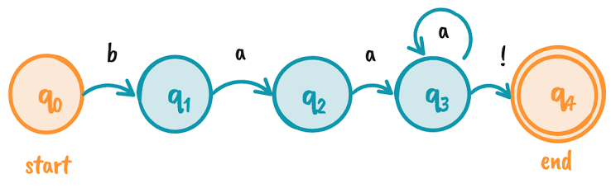
Finite-state automata (FSA) in Natural Language Processing (NLP) are abstract mathematical models used to recognize patterns, validate strings, and process text sequentially through a defined set of states and transitions. They are defined by five key components: states (Q), input alphabet (Σ), transition function (δ), start state (q₀), and accepting states (F)

Slide 70
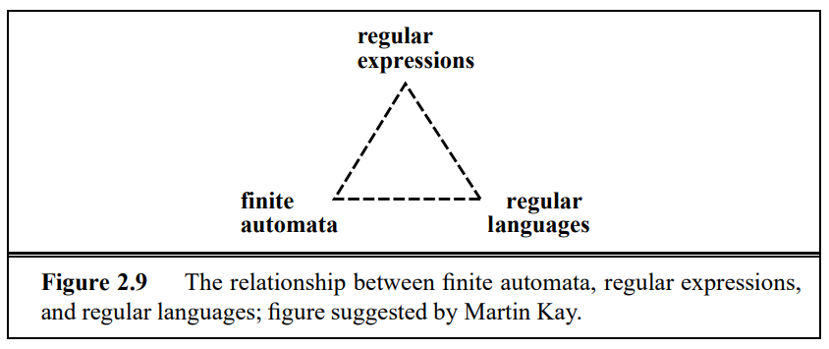

Slide 71
Using an FSA to Recognize Sheeptalk
After a while, with the parrot’s help, the Doctor got to learn the language of the animals so well that he could talk to them himself and understand everything they said.
Hugh Lofting, The Story of Doctor Dolittle
Let’s begin with the ‘sheep language’ we discussed previously. Recall that we defined the sheep language as any string from the following (infinite) set:
baa!
baaa!
baaaa!
baaaaa!
baaaaaa! . . .

Slide 72
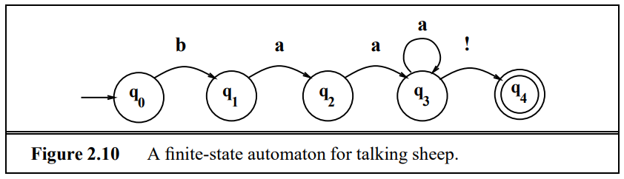
The regular expression for this kind of ‘sheep talk’ is /baa+!/. Figure 2.10 shows an automaton for modeling this regular expression. The automaton (i.e. machine, also called finite automaton, finite-state automaton, or FSA) recognizes a set of strings, in this case the strings characterizing sheep talk, in the same way that a regular expression does.

Slide 73
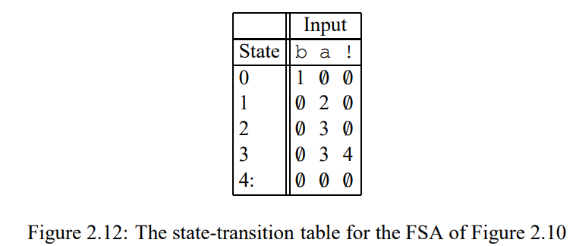
We can also represent an automaton with a state-transition table. As in the graph notation, the state-transition table represents the start state, the accepting states, and what transitions leave each state with which symbols. Here’s the state-transition table for the FSA of Figure 2.10.

Slide 74
Morphological analysis
Natural Language Processing (NLP) is one of the most rapidly growing areas of research. The findings of Morphological Analysis and Morphological Generation might be considered highly relevant in most Natural Language Processing applications. Because morphological analysis is a technique for recognising a word, the result can be employed at a later stage.
Morphological analysis is a field of linguistics that studies the structure of words. It identifies how a word is produced through the use of morphemes.
A morpheme is a basic unit of the English language. The morpheme is the smallest element of a word that has grammatical function and meaning.
Free morpheme and bound morpheme are the two types of morphemes. A single free morpheme can become a complete word.

Slide 75
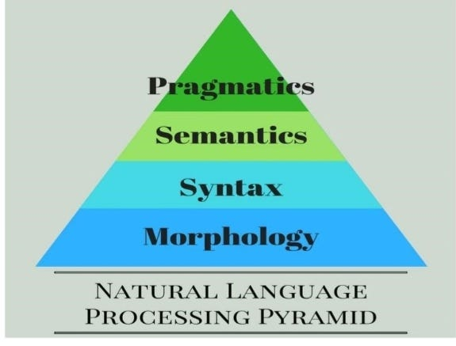

Slide 76
For instance, a bus, a bicycle, and so forth. A bound morpheme, on the other hand, cannot stand alone and must be joined to a free morpheme to produce a word. ing, un, and other bound morphemes are examples.
Inflectional Morphology and Derivational Morphology are the two types of morphology. Both of these types have their own significance in various areas related to the Natural Language Processing.

Slide 77
What is a morphological analyzer ?
In inflected languages, words are formed through morphological processes such as affixation. For example, by adding the suffix ‘-s’ to the verb ‘to dance’, we form the third person singular ‘dances’.
A morphological analyzer assigns the attributes of a given word by evaluating what morphological processes the form has undergone.If you give it the word ‘bailaré’ in Spanish, it will tell you it is the first person, singular, simple future, indicative form of the verb ‘bailar’.

Slide 78
Morphological Parsing.
It is the process of determining the morphenes from which a given word is constructed. Morphenes are the smallest meaningful words which cannot be divided further. Morphenes can be stem or afix. Stem are the root word whereas afix can be prefix, suffix or infix. For example-
Unsuccessfull → un success ful
(prefix) (stem) (suffix)
Order of words also decide the morphological parser. To design a morphological parser we require three things- lexicon, morphptactics and orthographic rules.

Slide 79
APPROACHES TO MORPHOLOGY
• Morpheme Based Morphology :
In these words are analyzed as arrangements of morphemes.Word-based morphology is (usually) a word-and-paradigm approach. The theory takes paradigms as a central notion.
Lexeme Based Morphology:
Lexeme-based morphology usually takes what it is called an “item-and process” approach. Instead of analyzing a word form as a set of morphemes arranged in sequence , a word form is said to be the result of applying rules that alter a word-form or steam in order to produce a new one.
Word based Morphology :
Word-based morphology is usually a word-and -paradigm approach.instead of stating rules to combine morphemes into word forms.

Slide 80
Word-internal structure
• What’s inside a word?
• walk, walked, walks: Our models think these are
different. Should they be?
• Motivations: less sparsity, deeper understanding
• Orthography: spelling conventions
• “blacke as the night” vs “black as the night”
Not really linguistically meaningful
• yesss vs yesssssssss
(Linguistically meaningful?...)
• Morphology: linguistically productive
• Rule-based approaches are very common here

Slide 81
Morphology: Phenomena
Inflection
Derivation
Compounding
Cliticization

Slide 82
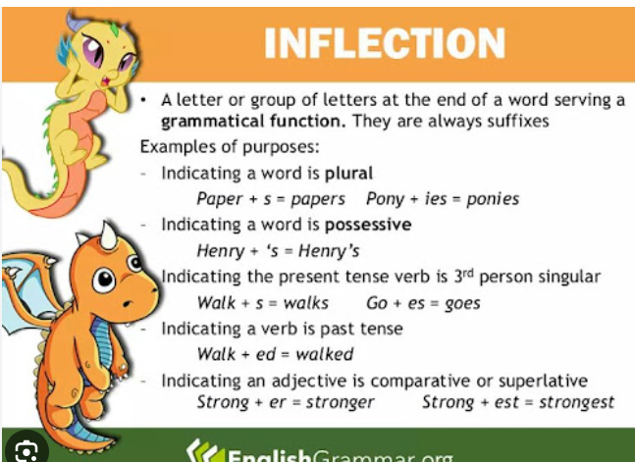
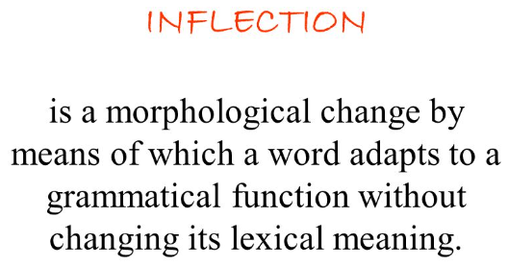

Slide 83
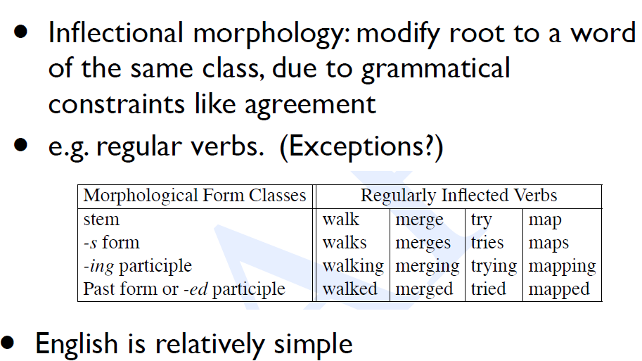

Slide 84
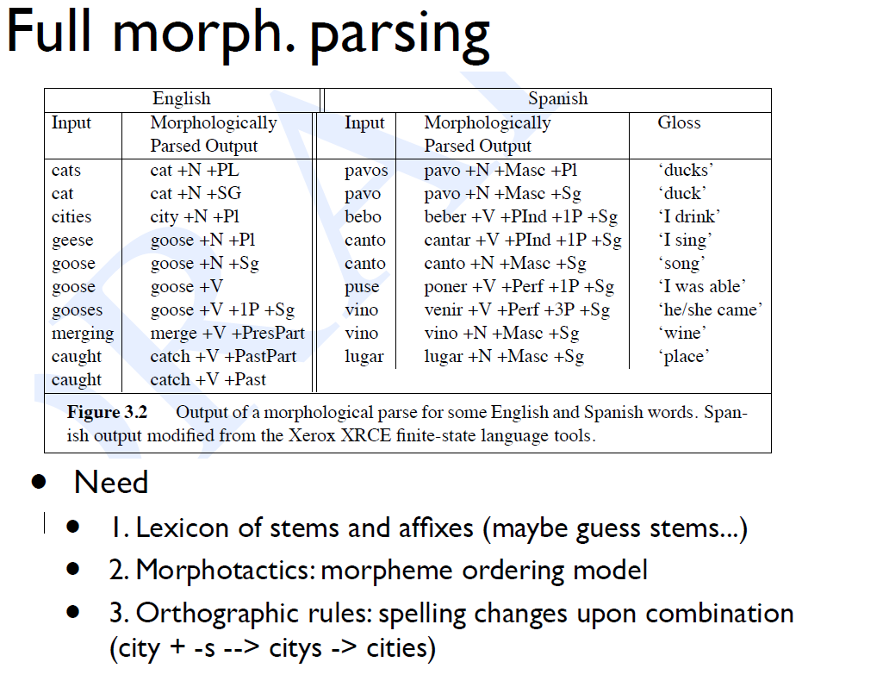

Slide 85
Derivation
Morphological derivation is the linguistic process of creating a new word from an existing base or root, usually by adding prefixes or suffixes (e.g., changing "happy" to "unhappy" or "happiness"). It alters the core meaning or changes the grammatical word

Slide 86
Compounding
a word-formation process that joins two or more independent base words or root morphemes together to create a brand-new lexeme with a distinct meaning.
Combination of Stems: Unlike derivation (which adds affixes to a base), compounding links two separate lexical stems (e.g., dog + house = doghouse).

Slide 87
Cliticization is a linguistic process where a word-like element (a clitic) loses its independent stress and attaches phonologically to a neighboring word (the host). ). It bridges syntax and morphology, acting like an affix in pronunciation but functioning like a full word in a sentence.

Slide 88
Transducer
A Finite State Transducer (FST) in Natural Language Processing (NLP) is a computational machine that maps one input sequence of symbols to an output sequence of symbols. Unlike basic automata that only accept or reject strings, FSTs translate words or sounds into structured data, making them essential tools for linguistic analysis and speech processing.

Slide 89
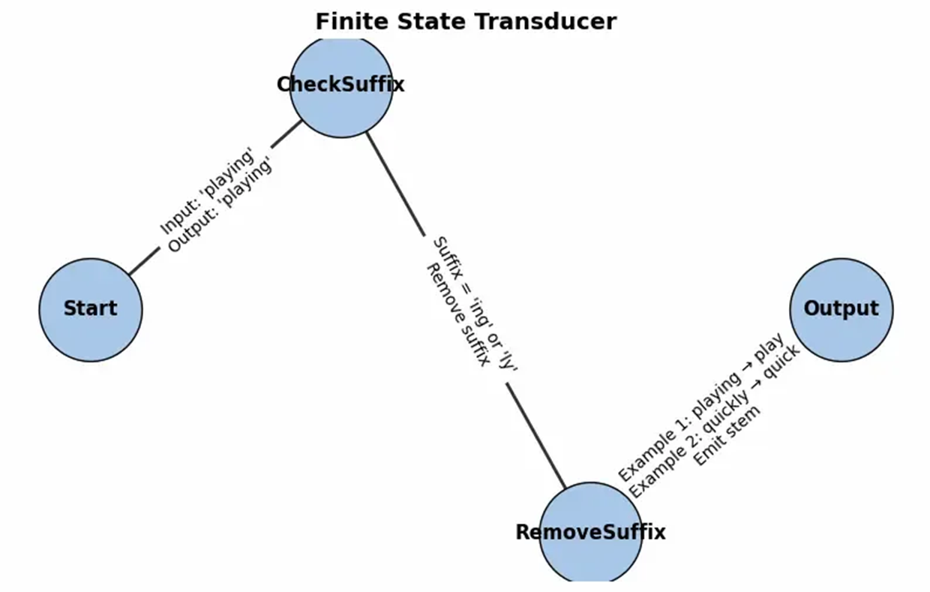

Slide 90
What is Tokenization?
Tokenization breaks text into smaller parts for easier machine analysis, helping machines understand human language.
Tokenization, in the realm of Natural Language Processing (NLP) and machine learning, refers to the process of converting a sequence of text into smaller parts, known as tokens. These tokens can be as small as characters or as long as words. The primary reason this process matters is that it helps machines understand human language by breaking it down into bite-sized pieces, which are easier to analyze.

Slide 91
To delve deeper into the mechanics, consider the sentence, "Chatbots are helpful." When we tokenize this sentence by words, it transforms into an array of individual words:
["Chatbots", "are", "helpful"].
This is a straightforward approach where spaces typically dictate the boundaries of tokens. However, if we were to tokenize by characters, the sentence would fragment into:
["C", "h", "a", "t", "b", "o", "t", "s", " ", "a", "r", "e", " ", "h", "e", "l", "p", "f", "u", "l"].
This character-level breakdown is more granular and can be especially useful for certain languages or specific NLP tasks.

Slide 92
Types of Tokenization
Tokenization methods vary based on the granularity of the text breakdown and the specific requirements of the task at hand. These methods can range from dissecting text into individual words to breaking them down into characters or even smaller units. Here's a closer look at the different types:
Word tokenization. This method breaks text down into individual words. It's the most common approach and is particularly effective for languages with clear word boundaries like English.
Character tokenization. Here, the text is segmented into individual characters. This method is beneficial for languages that lack clear word boundaries or for tasks that require a granular analysis, such as spelling correction.
Subword tokenization. Striking a balance between word and character tokenization, this method breaks text into units that might be larger than a single character but smaller than a full word. For instance, "Chatbots" could be tokenized into "Chat" and "bots". This approach is especially useful for languages that form meaning by combining smaller units or when dealing with out-of-vocabulary words in NLP tasks.

Slide 93
The detection and correction of spelling errors
The detection and correction of spelling errors is an integral part of modern word-processors.
The very same algorithms are also important in applications in which even the individual letters aren’t guaranteed to be accurately identified: optical character recognition (OCR) and on-line handwriting recognition.
Optical character recognition is the term used for automatic recognition of machine or hand-printed characters. An optical scanner converts a machine or hand-printed page into a bitmap which is then passed to an OCR algorithm.

Slide 94
we will focus on detection and correction of spelling errors, mainly in typed text, but the algorithms will apply also to OCR and handwriting applications.
OCR systems have even higher error rates than human typists, although they tend to make different errors than typists. For example OCR systems often misread ‘D’ as ‘O’ or ‘ri’ as ‘n’, producing ‘mis-spelled’ words like dension for derision, or POQ Bach for PDQ Bach.

Slide 95
spelling correction, breaks the field down into three increasingly broader problems:
1. non-word error detection: detecting spelling errors which result in non-words (like graffe for giraffe).
2. isolated-word error correction: correcting spelling errors which result in non-words, for example correcting graffe to giraffe, but looking only at the word in isolation.
3. context-dependent error detection and correction: Using the context to help detect and correct spelling errors even if they accident tally result in an actual word of English (real-word errors). This REAL-WORD ERRORS can happen from typographical errors (insertion, deletion, transposition) which accidently produce a real word (e.g. there for three), or because the writer substituted the wrong spelling of a homophone or near-homophone (e.g. dessert for desert, or piece for peace).
The next section will discuss the kinds of spelling-error patterns that occur in typed text and OCR and handwriting-recognition input.

Slide 96
1 INSERTION
insertion: mistyping the as ther
DELETION
deletion: mistyping the as th
SUBSTITUTION
substitution: mistyping the as thw
TRANSPOSITION
transposition: mistyping the as hte

Slide 97
Types of Spelling Errors
Non-word errors: Words that do not exist in a standard lexicon (e.g., typing "intellagence" instead of "intelligence").
Real-word errors: Valid words that are contextually wrong, often caused by typos or homophones (e.g., using "bear" instead of "pear").

Slide 98
Insertion Error
An insertion error occurs when an extra letter, character, or word is added to a correctly spelled word.
Examples:
recieve → not insertion; this is a substitution/transposition issue.
bookk → book (extra “k”)
committeee → committee (extra “e”)
tehree → three (extra letter)

Slide 99
Deletion Error
A deletion error occurs when a letter, character, or word is accidentally omitted from the correctly spelled word.
Examples:
recieve → not deletion
adress → address (missing “d”)
becaus → because (missing “e”)
enviroment → environment (missing “n”)

Slide 100
Transposition Error
A transposition error occurs when two adjacent letters are accidentally swapped or placed in the wrong order.
Examples:
teh → the (“e” and “h” are swapped)
recieve → receive (“i” and “e” are transposed)
form → from (“o” and “r” are swapped)

Slide 101
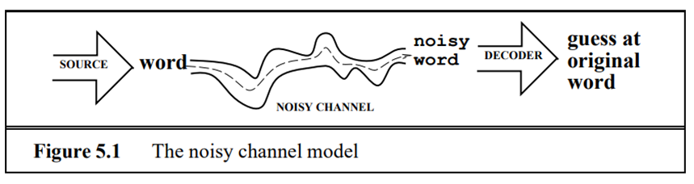

Slide 102
Minimum edit distance
the smallest number of changes needed to turn one word or text string into another. The three allowed operations are insertion (adding a letter), deletion (removing a letter), and substitution (swapping one letter for another). Each step usually counts as a cost of one.

Slide 103
Minimum Edit Distance
It is the minimum number of editing operations required
to convert one word into another.
The three basic operations are:
Insertion – Add a character
cat → cart (+ r)
Deletion – Remove a character
cart → cat (− r)
Substitution – Replace one character
cat → cut (a → u)

Slide 104
Example
To convert “kitten” → “sitting”:
kitten → sitten — substitution
sitten → sittin — substitution
sittin → sitting — insertion
Minimum Edit Distance = 3
Application in NLP:
MED is widely used for spelling correction, word similarity, OCR error correction, and text comparison.

